Slide 1
Lecture 13
Thévenin’s Theorem

Slide 2
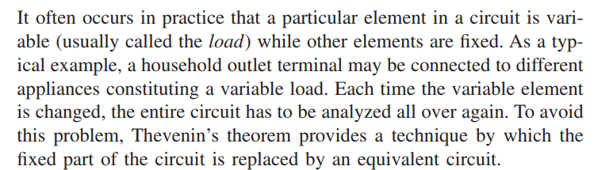
Thévenin Theorem

Slide 3
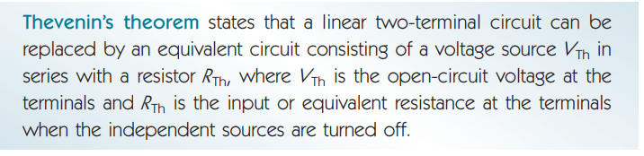
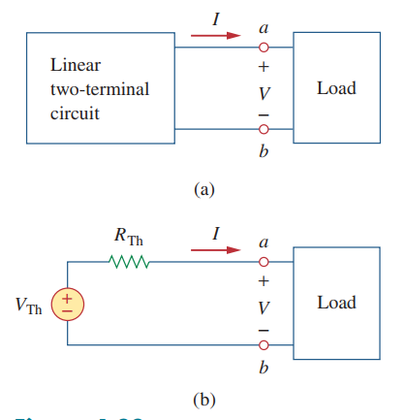
Original Circuit
Thevenin Equivalent Circuit

Slide 4
Thévenin Equivalent
L. C. Thévenin -- French engineer; published his theorem in 1883
E. L. Norton -- scientist with Bell Telephone Laboratories
Any linear circuit network at two terminals may be replaced with a Thévenin equivalent (V_{TH}, R_{TH}).
The equivalent will behave the same as the original network (v_{L}, i_{L}) with respect to those two terminals.

Slide 5
Method to find Thévenin Equivalent
Determining V_{TH} and R_{TH} with respect to two terminals:
Open the load and determine the open-circuit voltage (V_{OC}), then deactivate all independent sources (short-circuit the V sources and open-circuit the I sources) and find the equivalent resistance (R_{eq}).

Slide 6

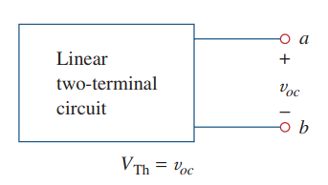

i) Thevenin Voltage $V_{TH}$
Open circuit voltage across the terminals

Slide 7
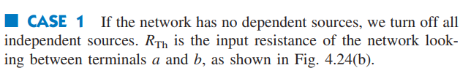
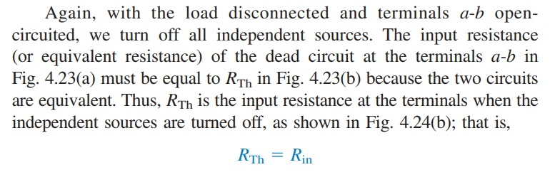
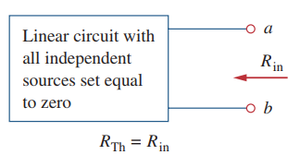

ii) Thevenin Resistance $R_{TH}$

Slide 8
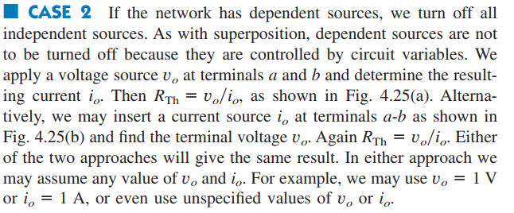
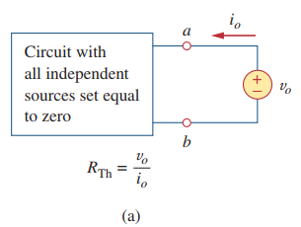
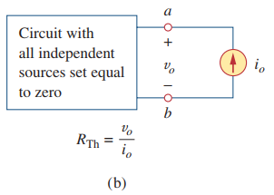

Slide 9
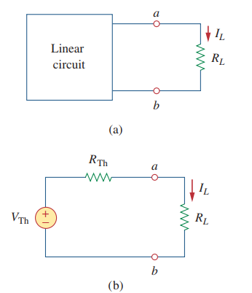

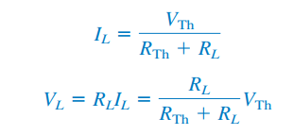

Slide 10

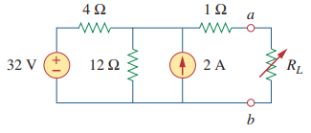
Example 01

Slide 11
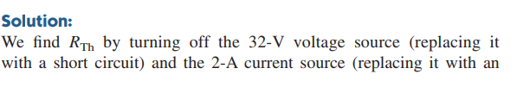

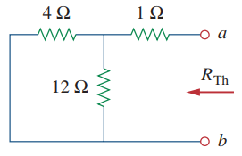
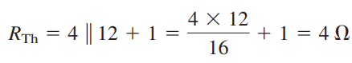

Finding $R_{TH}$

Slide 12
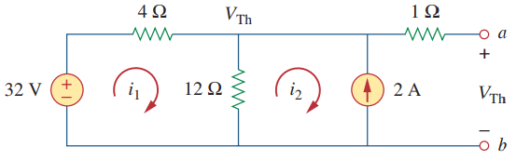
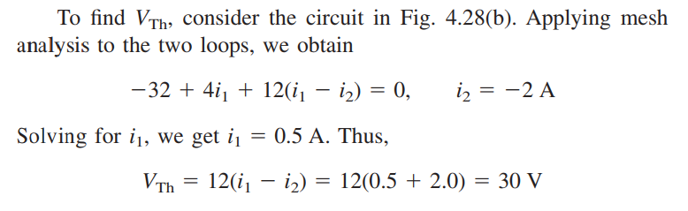

Finding $V_{TH}$

Slide 13
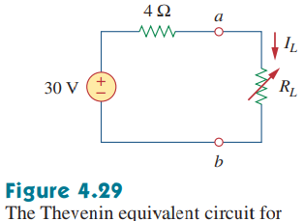

Slide 14
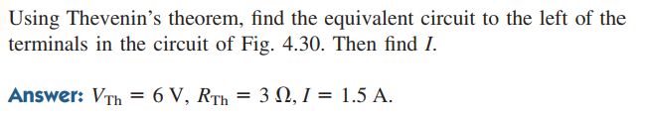
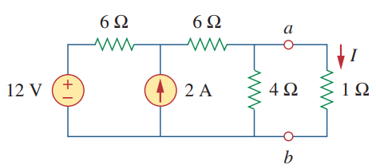
Practice Problem 4.8

Slide 15
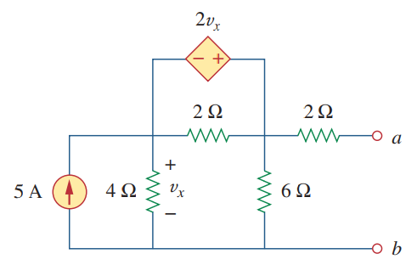
Example 02

Slide 16
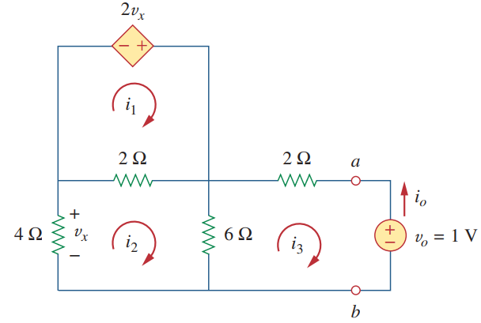
Finding $R_{TH}$

Slide 17
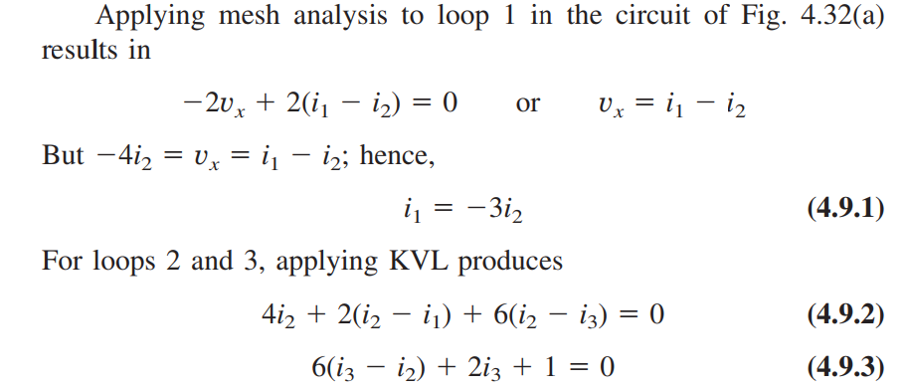
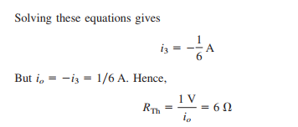

Slide 18
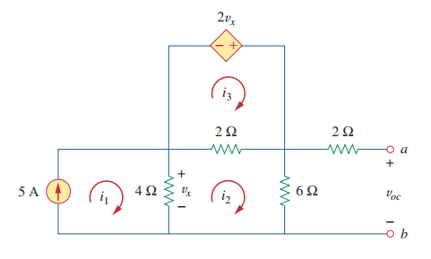
Finding $V_{TH}$

Slide 19
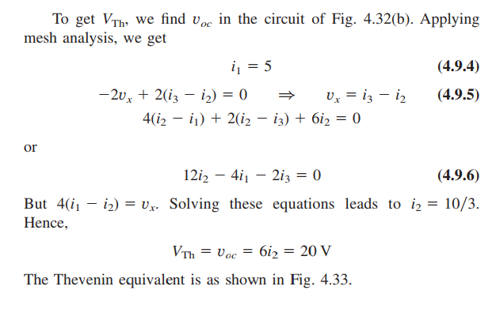

Slide 20
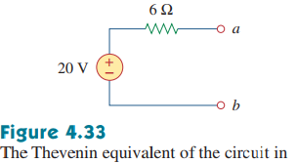

Slide 21
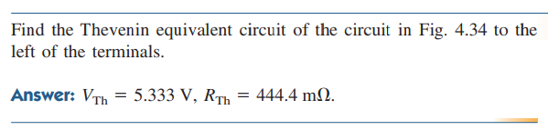
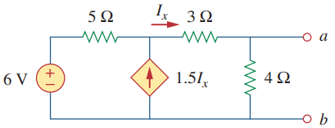
Practice Problem 4.9

Slide 22
Thank You

